Slide 1
OpEx 2.1: Build and Deploy Automation
Control-M Automation

Slide 2
Control-M – meeting notes
Attendees
Deployment Team
Ram, Mike, Steve, Eric, Robert, Reedy, Suraj, Jeffrey, Avikal, Kuldeep
Application Owner
Carl A. Robertson
Action Items
Reedy will send out short summary showing workflow
Carl will work with his tech team to see if its possible to put an agent on one of the lab machines
Eric will review and provide an estimate to complete for planning purposes

Slide 3
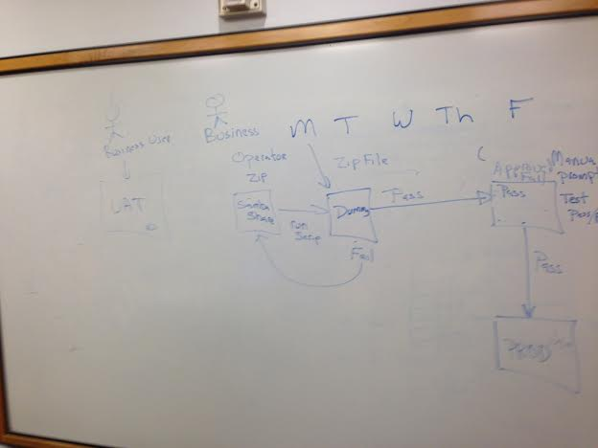
Screenshot from meeting

Slide 4
Control-M Environments
Release Management
PROD
Engineers
End Users
UAT
Lab Machine
DEV

Slide 5
Current Deployment Scenario
End Users use Dev environment to develop changes in Control-M.
Control-M changes are exported, zipped up and put on Samba share
Script is used to move zip file from Samba to UAT (or Samba share to PROD)
Unzip Control-M zip file, individual files are in xml format, and imported into Control-M. End Users test changes in the UAT environment
Changes are exported from Control-M and put back on Samba share
Once ready a release is scheduled (GCM is schedule)
Prior to GCM date Operator move zip file containing exported Control-M changes (xml format) samba
Operator executes script to move zip file from samba to dummy server (staging server). A quick validation is run to make sure file wasn’t changed or is corrupted.
If passes sanity testing then approved for Production
On scheduled date files are moved from dummy to PROD

Slide 6
Current State
Operator
Release Management
End Users
Operator runs scripts to send files to dummy server
Samba
Dummy
server
Test case - Passes
Production
Server
Test case - Fails
Release Manager manually validates files are correct

Slide 7
Target State
Release Manager manually validates files are correct
Operator
Release Management
End Users
Nexus
Samba
Dummy
server
Production
Server
Test case - Passes
Test case - Fails
Multiple stage automation will be required as there is a manual validation step on the Dummy sever that can’t be automated currently
Phase 1 approach is to use a Shell step running Control-M cli for any integration with Control-M
Automate moving file from Nexus to Samba share
Automate moving file from Samba to Dummy Server
Manual test approval
Pass will allow deployment to PROD
Failure will trigger notification to either Operator or End User

